Slide 1
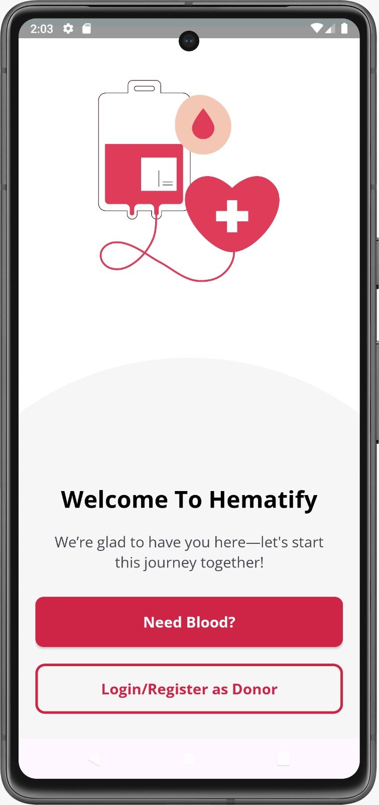

Hematify- From your veins to their hearts

Slide 2
Contents
01
02
03
Introduction to Hematify
Functionalities of Hematify
Need for hematify
04
05
06
Team contribution
Development Timeline
Impact and Future Scope

Slide 3
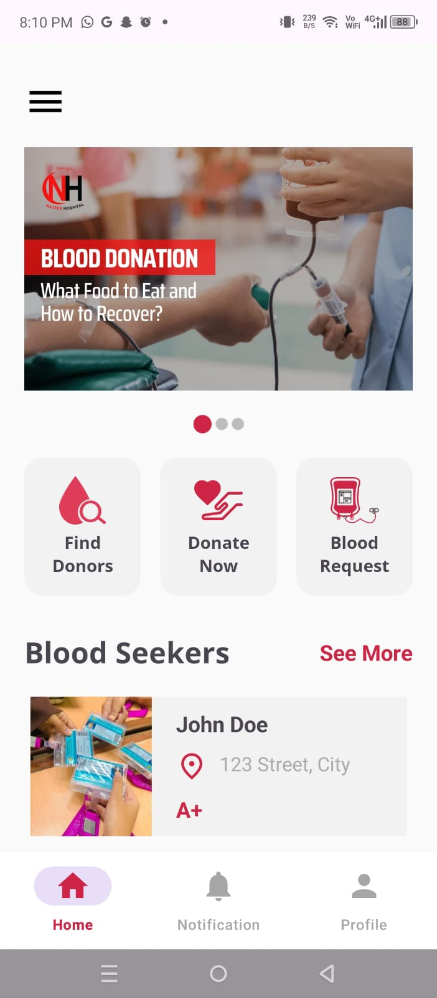
1. Introduction
Our blood donation app bridges the gap between donors and recipients, addressing the lack of a centralized platform to find specific blood groups.
Users can search for donors by location, view profiles, and contact them .
Donors can create profiles and add all their information needed to donate blood.
Built with Java (Android Studio) and Firebase, the app simplifies the donor search process, saving lives efficiently.

Slide 4
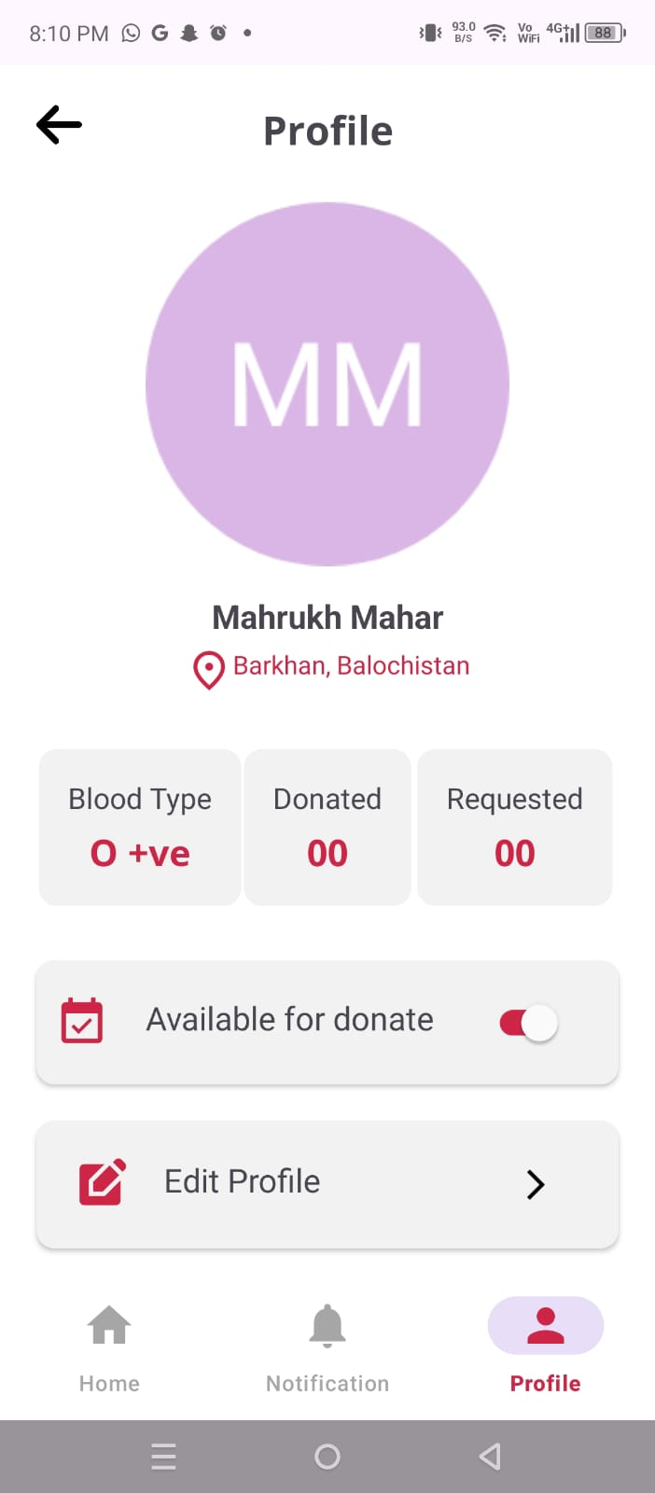
2. Functionalities
Easy Sign-up: Users can quickly create accounts and register as donors.
Donor Search: Search for donors by filtering location and blood type.
Donor Profiles: Donors can create detailed profiles to offer help. Contact Donors: Recipients can view donor profiles and contact them directly via provided contact information.

Slide 5
3. Need for Hematify
Current Challenges:
No centralized platform to find blood donors.
People rely on inefficient methods like WhatsApp groups or social media statuses.
Time-consuming and unreliable during emergencies.
Solution Provided by Hematify:
Centralized platform to connect donors and recipients.
Easy search for donors by location and blood type.
Direct communication between donors and recipients.

Slide 6
4. Team Contribution
Our team of four members collaborated to develop the Blood Donation App. The following sections outline each member's contributions:
UI/UX Design
- Nashrah (22sw135)
- Hafsa (22sw020)
Sign-up and Sign-in Features
- Mahrukh (22sw002)
- Fatima (22sw038)
Location-based Donor Search
- Mahrukh
- Hafsa Notification System -By All

Slide 7
5. Development Timeline
App Design:
Start Date: 30th December
End Date: 4th January
Focused on UI/UX design, and finalizing the app flow. App Development:
Start Date: 22nd January
Frontend & Backend Worked Simultaneously:
Frontend: Built user interfaces using Java (Android Studio).
Backend: Integrated Firebase for authentication and firebase firestore for real-time data management.

Slide 8
5. Development Timeline
Key Features Implemented:
Donor and recipient profiles: January 22 - January 26 (2 weeks)
- Designed and developed user profiles for donors and recipients
- Implemented profile management features
Location-based donor search: January 27 - By adding provinces and cities. Blood request posting and notifications: Starting from January 28 (Still working on it) - Creating a system for recipients to post blood requests
- Implementing notification system for donors and recipients

Slide 9
6. Impact and Future Scope
Impact
Saves Lives: Ensures timely access to blood donations during emergencies.
Efficiency: Streamlines the donor-recipient connection process.
Awareness: Encourages more people to register as donors.
Community Building: Creates a reliable network of donors and recipients.

Slide 10
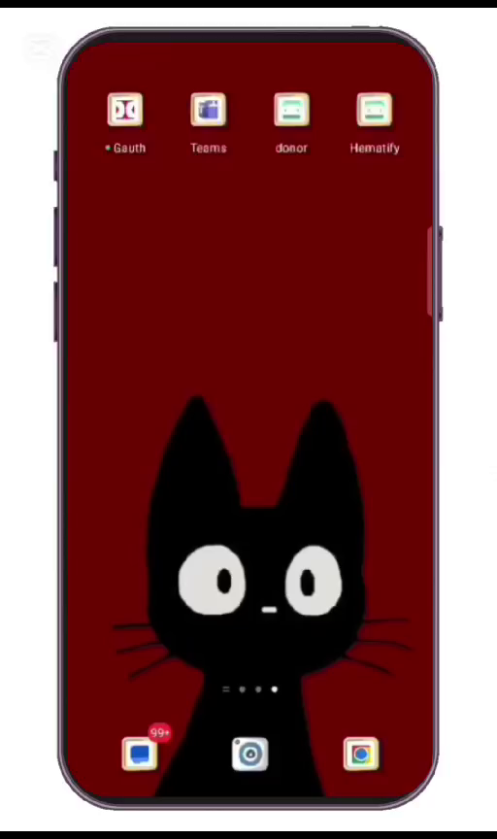
6. Impact and Future Scope
Future Scope
Expansion: Scale the app to cover more regions and countries.
Advanced Features:
Integration with hospitals and blood banks for real-time blood availability tracking also integrating with google maps api for real-time location search.
Notification System: Allow recipients to send blood requests that reach donors as instant notifications. Donors can accept or decline requests based on availability.
Real-time tracking of blood availability and donor responses.
Multilingual Support: Make the app accessible to a wider audience.

